Slide 1
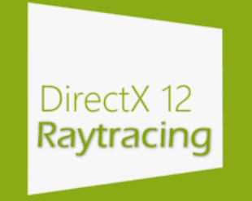
RTX-Explore github.com/rtx-on/rtx-explore Path Tracer
Liam Dugan · Henry Zhu · Ziad Ben Hadj-Alouane

Slide 2
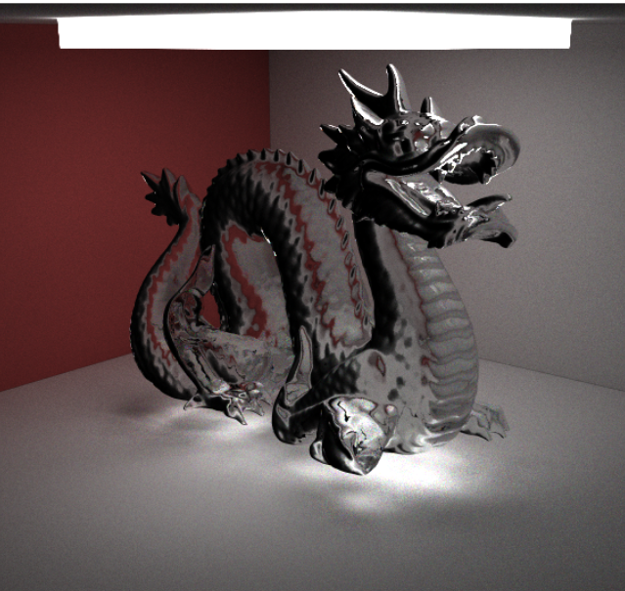
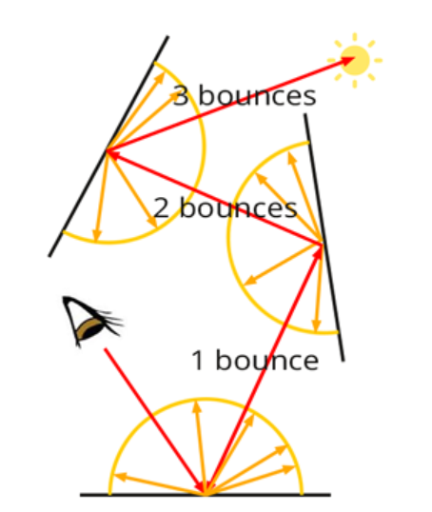
What is a Path Tracer?

Slide 3
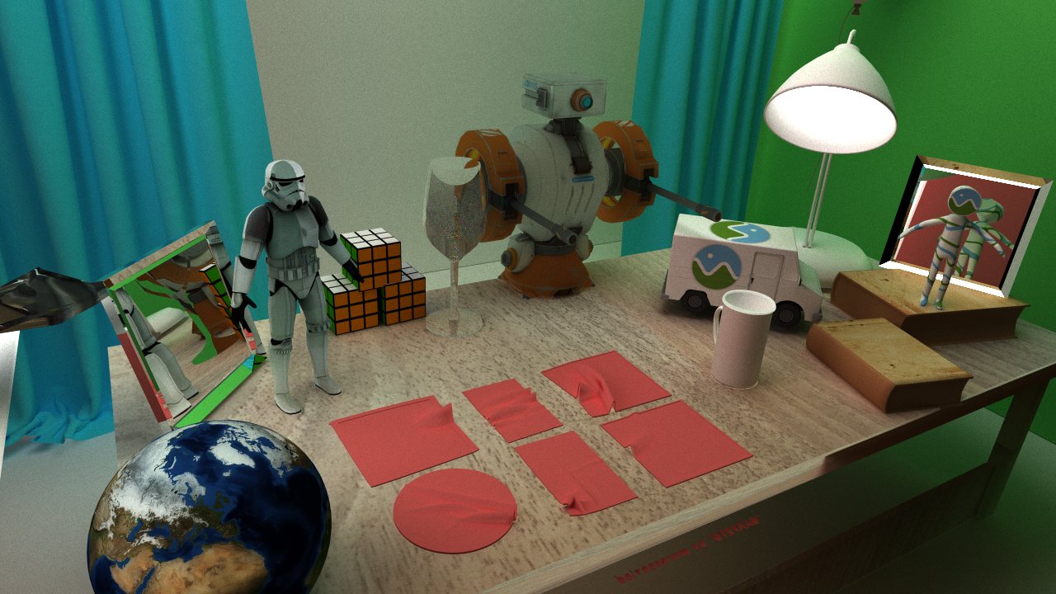

Slide 4
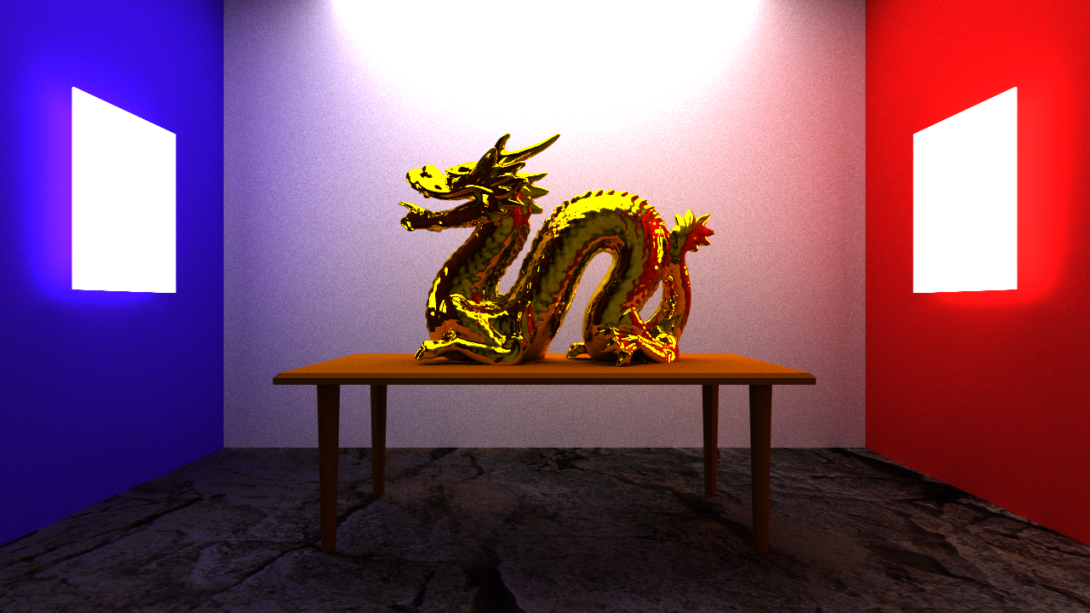

Slide 5
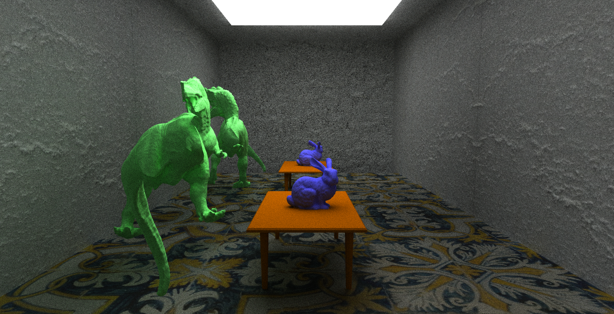

Slide 6
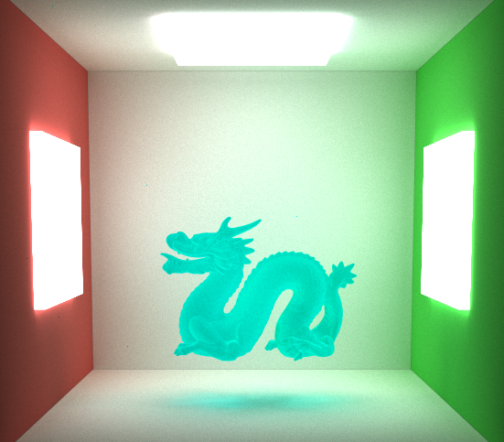
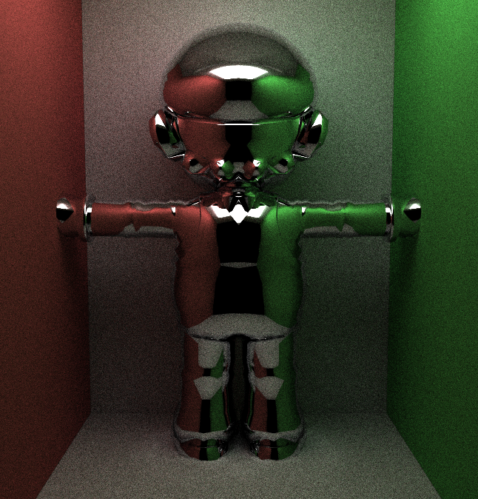

Slide 7
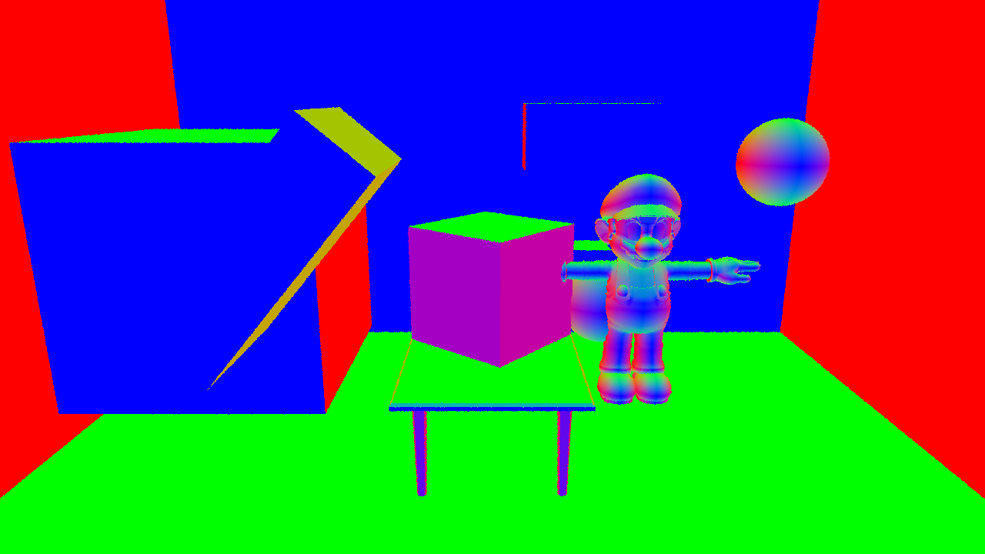

Slide 8
Features
glTF scenes & .obj meshes loading
Texture loading & normal mapping
Materials - Diffuse/specular/dispersive/transmittive
Subsurface Scattering
Scene Building with GUI
Anti-aliasing & depth of field

Slide 9
Live Demo: Release Code at github.com/rtx-on/rtx-explore/releases

Slide 10
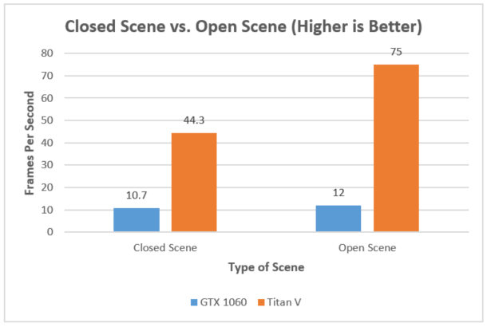
Closed vs. Open scenes

Slide 11
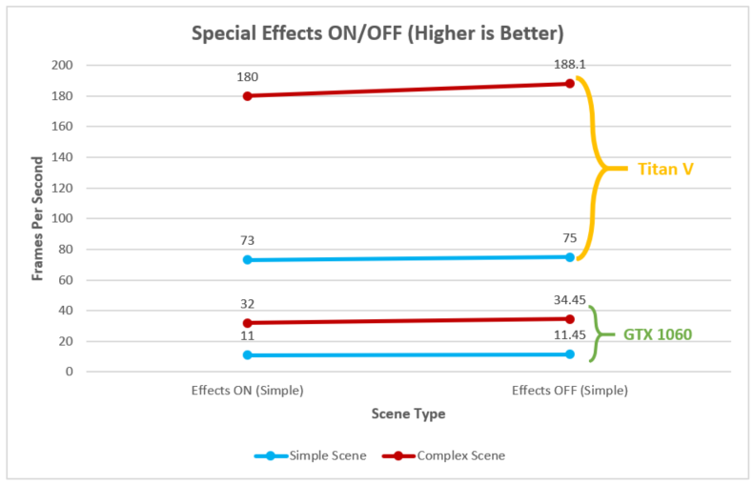
Special Effects

Slide 12
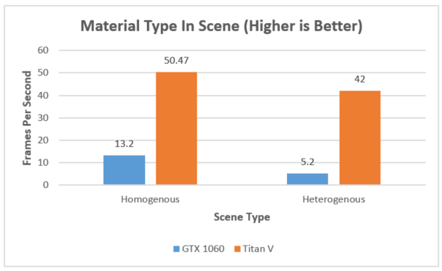
Material Types

Slide 13
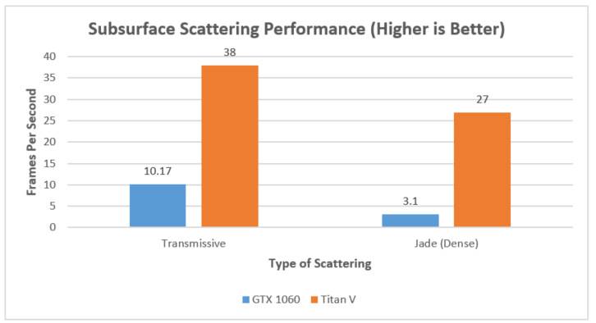
Subsurface Scattering

Slide 14
RTX-Explore github.com/rtx-on/rtx-explore Path Tracer
Thank you!

